Slide 1
FUNDAMENTALS OF SOFTWARE PROJECT MANAGEMENT
Risk Management
Lecture-10

Slide 2
Risk management
This lecture will touch upon:
Definition of ‘risk’ and ‘risk management’
Some ways of categorizing risk
Risk management
  Risk identification – what are the risks to a project?
  Risk analysis – which ones are really serious?
  Risk planning – what shall we do?
  Risk monitoring – has the planning worked?
We will also look at PERT risk and critical chains

Slide 3
Some definitions of risk
risk is an uncertain event or condition that, if it occurs, has a positive or negative effect on one or more project objectives. PMBOK
‘the chance of exposure to the adverse consequences of future events’ PRINCE2
Project plans have to be based on assumptions
Risk is the possibility that an assumption is wrong
When the risk happens it becomes a problem or an issue
Notes:
Key elements of risk are as follows:
It relates to the future: The future inherently is uncertain. Something's which seems obvious when the project is over i.e. costs overrun, might not have been obvious during planning.
It involves cause and effect: A “cost-overrun” might be described as a Risk, “cost-overrun” describes some damage, but does not says what causes it. It can be untrained staff, wrong effort estimation or poor specification. But both cause and effect has to be recorded for each Risk.
Refer to Excel example.

Slide 4
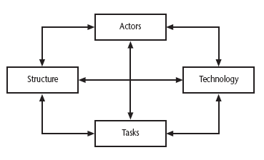
Categories of risk
Notes:
This is based on Lyytinen’s sociotechnical model of risk
Actors relate to all those involved in the project including both developers, users and managers e.g. a risk could be that high staff turnover leads to information of importance to the project being lost
Technology – both that used to implement the project and that embedded in the project deliverables – risk could be that the technologies selected are not in fact appropriate.
Structure – this includes management procedures, risk here is that a group who need to carry out a particular project task are not informed of this need because they are not part of the project communication network
Tasks – the work to be carried out. A typical risk is that the amount of effort needed to carry out the task is underestimated.
A risk could be well belong to more than one of the four areas – for example, estimates being wrong could be influenced by problems with actors (e.g. lack of experience with a technical domain) or the structure (over optimism of managers keen to win work).
Exercise 7.2 in the text will be some practice in identifying and categorizing risks

Slide 5
Categories of Risk - Continued
Task / Project
Structure
Actors
Technology
the types of task to be undertaken
the communication systems, management structures, work flows etc.
the people involved in the project
the methods, techniques and tools to be used

Slide 6
A framework for dealing with risk
The planning for risk includes these steps:
Risk identification – what risks might there be?
Risk analysis and prioritization – which are the most serious risks?
Risk planning – what are we going to do about them?
Risk monitoring – what is the current state of the risk?

Slide 7
Risk identification
Approaches to identifying risks include:
Use of checklists – usually based on the experience of past projects
Brainstorming – getting knowledgeable stakeholders together to pool concerns
Causal mapping – identifying possible chains of cause and effect

Slide 8
Boehm’s top 10 development risks
Risk | Risk reduction techniques
Personnel shortfalls | Staffing with top talent; job matching; teambuilding; training and career development; early scheduling of key personnel
Unrealistic time and cost estimates | Multiple estimation techniques; design to cost; incremental development; recording and analysis of past projects; standardization of methods
Developing the wrong software functions | Improved software evaluation; formal specification methods; user surveys; prototyping; early user manuals
Developing the wrong user interface | Prototyping; task analysis; user involvement
Notes:
Barry Boehm surveyed software engineering project leaders to find out the main risks that they had experienced with their projects. For each risk, some risk reduction techniques has been suggested.

Slide 9
Boehm’s top ten risk - continued
Gold plating | Requirements scrubbing, prototyping, design to cost
Late changes to requirements | Change control, incremental development
Shortfalls in externally supplied components | Benchmarking, inspections, formal specifications, contractual agreements, quality controls
Shortfalls in externally performed tasks | Quality assurance procedures, competitive design etc
Real time performance problems | Simulation, prototyping, tuning
Development technically too difficult | Technical analysis, cost-benefit analysis, prototyping , training
Notes:
‘Gold plating‘ refers to inclusion of features that in fact are unnecessary and which end up never actually being used.
Requirements Scrubbing is a practice in which a product specification is carefully examined for unnecessary or overly complex requirements, which are then removed.

Slide 10
Risk prioritization
Risk exposure (RE)
= (potential damage) x (probability of occurrence)
Ideally
Potential damage: a money value e.g. a flood would cause £0.5 millions of damage
Probability 0.00 (absolutely no chance) to 1.00 (absolutely certain) e.g. 0.01 (one in hundred chance)
RE = £0.5m x 0.01 = £5,000
Crudely analogous to the amount needed for an insurance premium
Notes:
If there were 100 people chipping in £5,000 each, there would be enough for the 1 in 100 chance of the flooding. If there were 2 floods then the system collapses!
Exercise 7.4 in the textbook is strongly recommended to explore these issues.
In practice, with project risks, these quantitative approaches are usually impractical and more qualitative approaches are used instead. See the next overhead.

Slide 11
Risk probability: qualitative descriptors
Probability level | Range
High | Greater than 50% chance of happening
Significant | 30-50% chance of happening
Moderate | 10-29% chance of happening
Low | Less than 10% chance of happening
Notes:
Managers would be happier identifying an approximate range rather than a precise probability.

Slide 12
Qualitative descriptors of impact on cost and associated range values
Impact level | Range
High | Greater than 30% above budgeted expenditure
Significant | 20 to 29% above budgeted expenditure
Moderate | 10 to 19% above budgeted expenditure
Low | Within 10% of budgeted expenditure.
Notes:
Similar tables can be produced for the impact on project duration and on the quality of project deliverables.
The problem with the qualitative approach is how do you combine the judgements about probability and impact – you can’t multiply them together.

Slide 13
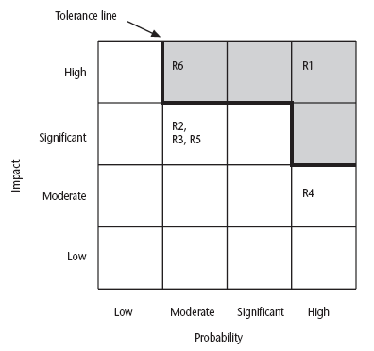
Probability impact matrix
Notes:
R1, R2 etc refer to particular risks (See Table 7.4 in the textbook). They are located on the grid according to the likelihood and impact ratings that have been allocated to them. A zone around the top right hand corner of the grid can be designated and risks falling within that zone are treated as requiring urgent action.

Slide 14
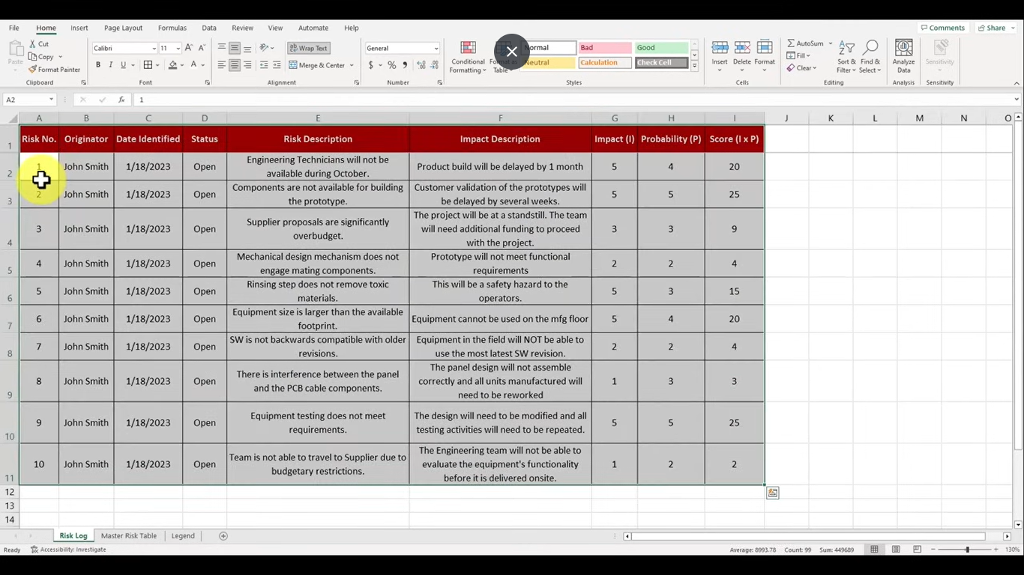

Slide 15
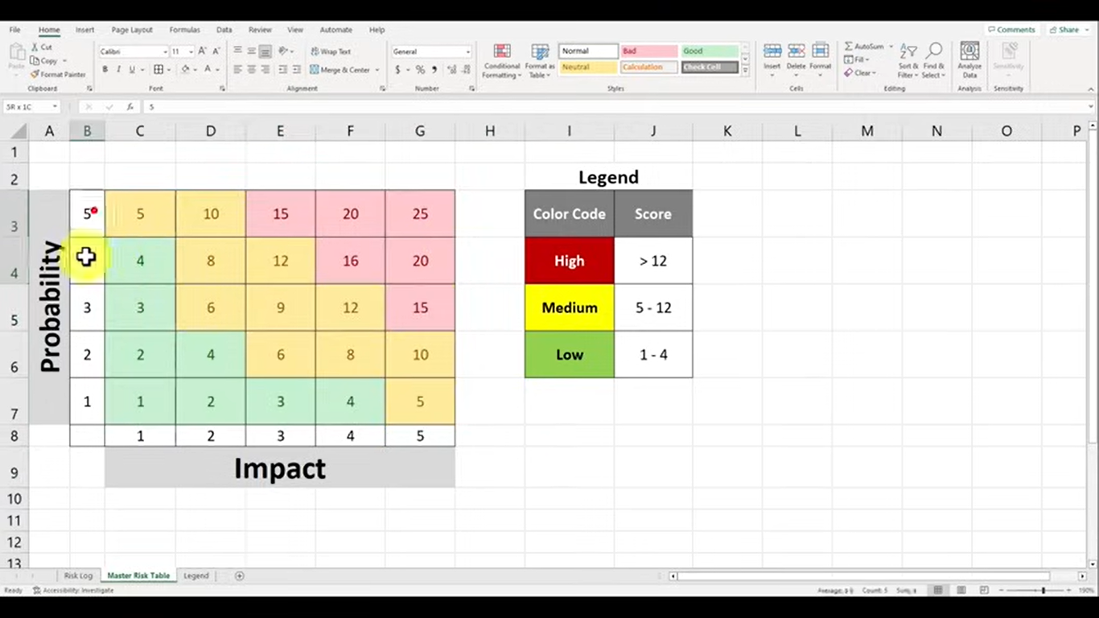

Slide 16
Risk planning
Risks can be dealt with by:
Risk acceptance
Risk avoidance
Risk reduction
Risk transfer
Risk mitigation/contingency measures
Notes:
Risk acceptance – the cost of avoiding the risk may be greater than the actual cost of the damage that might be inflicted
Risk avoidance – avoid the environment in which the risk occurs e.g. buying an OTS application would avoid a lot of the risks associated with software development e.g. poor estimates of effort.
Risk reduction – the risk is accepted but actions are taken to reduce its likelihood e.g. prototypes ought to reduce the risk of incorrect requirements
Risk transfer – the risk is transferred to another person or organization. The risk of incorrect development estimates can be transferred by negotiating a fixed price contract with an outside software supplier.
Risk mitigation – tries to reduce the impact if the risk does occur e.g. taking backups to allow rapid recovery in the case of data corruption

Slide 17
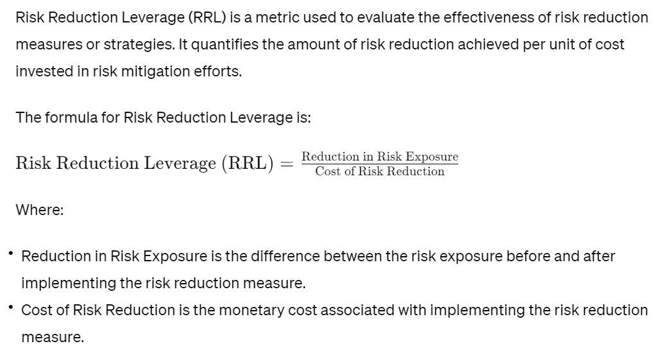
Risk reduction leverage
Notes:
A higher RRL value indicates that the risk reduction measure provides greater risk reduction per unit of cost, making it more efficient or beneficial to implement. Conversely, a lower RRL value suggests that the risk reduction measure may not be as cost-effective.

Slide 18
Risk reduction leverage
Risk reduction leverage =
(RE_{before}- RE_{after})/ (cost of risk reduction)
RE_{before}is risk exposure before risk reduction e.g. 1% chance of a fire causing £200k damage
RE_{after} is risk exposure after risk reduction e.g. fire alarm costing £500 reduces probability of fire damage to 0.5%
RRL = (1% of £200k)-(0.5% of £200k)/£500 = 2
RRL > 1.00 therefore worth doing
Notes:
the RRL value of 2 indicates that for every unit of cost (£500) invested in the risk reduction measure (fire alarm), there is a reduction in risk exposure equivalent to twice the investment, making it a worthwhile endeavor.

Slide 19
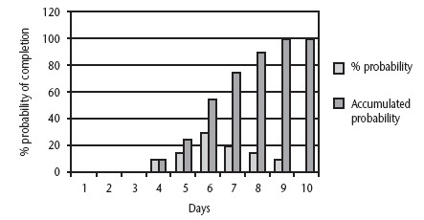
Probability chart
Notes:
As was pointed out in Chapter 5, an estimate of activity duration is realistically a range of values clustered around the most likely value are trailing off on either side of this central value.
How can we take account of this in project planning. An answer might be the PERT risk technique.

Slide 20
What is RMMM?
RMMM = Risk Mitigation, Monitoring and Management
An effective strategy to deal with risks must consider issues such as:
  Risk avoidance
  Risk monitoring
  Risk management and contingency planning
RMMM steps incur additional project cost
The goal of the RMMM plan is to identify as many potential risks as possible.
Notes:
By implementing the RMMM process, project managers can proactively identify and address potential risks, ultimately increasing the likelihood of project success and minimizing the impact of unforeseen events.

Slide 21
Using PERT to evaluate the effects of uncertainty
Three estimates are produced for each activity
Most likely time (m)
Optimistic time (a)
Pessimistic (b)
‘expected time’ t_{e} = (a + 4m +b) / 6
‘activity standard deviation’ S = (b-a)/6
Notes:
Most likely time (m) the time we would expect the task to take normally
Optimistic time (a) the shortest time could be realistically be expected
Pessimistic (b) worst possible time (only 1% chance of being worse, say)
Some straightforward activities (data input of standing data might perhaps be an example) might have little uncertainty and therefore have a low standard deviation, while others (software design, for instance?) have more uncertainty and would have a bigger standard deviation.
Exercise 7.6 in the textbook will give some practice in calculating these values.

Slide 22
A chain of activities
Task A
Task B
Task C
Task | a | m | b | t_{e} | s
A | 10 | 12 | 16 | ? | ?
B | 8 | 10 | 14 | ? | ?
C | 20 | 24 | 38 | ? | ?
Notes:
Fill the missing gaps?
T_{e}
Task A t_{e} = (10+ (12 x 4) + 16)/ 6 i.e. 12.66 s = (16-10)/6 i.e. 1
Task B t_{e} = (8 + (10 x 4) + 14)/ 6 i.e. 10.33 s = (14-8)/6 i.e. 1
Task C T_{e} = (20 + (24 x 4) + 38)/6 i.e. 25.66 s = (38-20)/6 i.e. 3

Slide 23
A chain of activities
What would be the expected duration of the chain A + B + C?
Answer: 12.66 + 10.33 + 25.66 i.e. 48.65
What would be the variance for A + B+ C?
Answer: square root of (1² + 1² + 3²) i.e.
3.32

Slide 24
Assessing the likelihood of meeting a target
Say the target for completing A+B+C was 52 days (T)
Calculate the z value thus
z = (T – t_{e})/s
In this example z = (52-48.33)/3.32 i.e. 1.01
Look up in table of z values – see next overhead

Slide 25
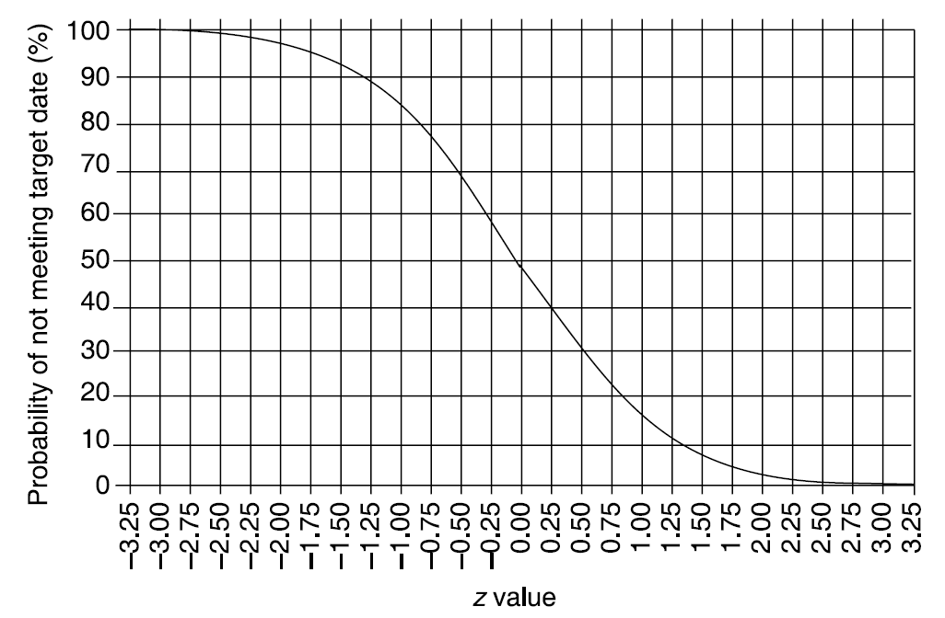
Graph of z values
Notes:
There is about a 15% chance of not meeting the target of 52 days.

Slide 26
Critical chain approach
One problem with estimates of task duration:
Estimators add a safety zone to estimate to take account of possible difficulties
Developers work to the estimate + safety zone, so time is lost
No advantage is taken of opportunities where tasks can finish early – and provide a buffer for later activities
Notes:
Buffer time is extra time added to a service duration that you use to clean up after the appointment, or prepare for the next appointment.

Slide 27
Critical chain approach
One answer to this:
Base targets on midpoints (i.e. t_{e})
Accumulate 50% of the safety zones (between t_{e} and b) into a buffer at the end of the project
Work backwards and start all activities at their latest start dates
During project execution use relay race model
Notes:
This approach means that the ‘safety buffer’ in the estimate for an activity is moved from the individual developer to the project as a whole.
The ‘relay race’ principle is that the project manager makes sure that team members are ready to immediately start dependent activities as soon as the preceding activity is finished.

Slide 28
Activity |  | Duration (weeks) | Precedents
A | Hardware selection | 6
B | Software design | 4
C | Install hardware | 3 | A
D | Code & test software | 4 | B
E | File take-on | 3 | B
F | Write user manuals | 10
G | User training | 3 | E, F
H | Install & test system | 2 | C,D

Slide 29
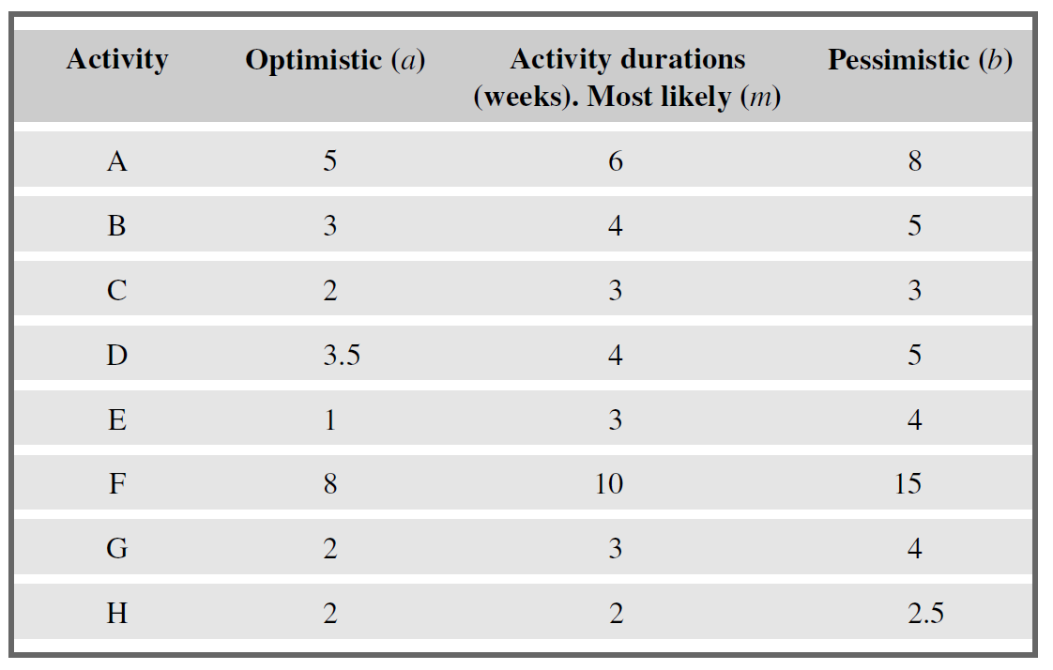

Slide 30
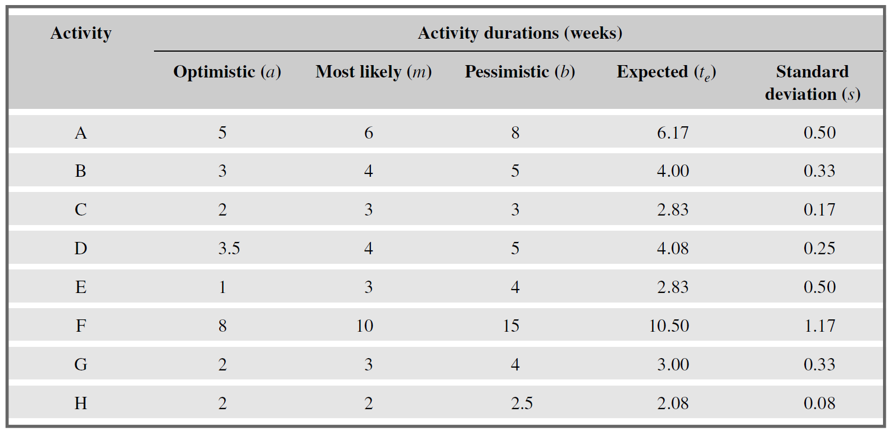

Slide 31
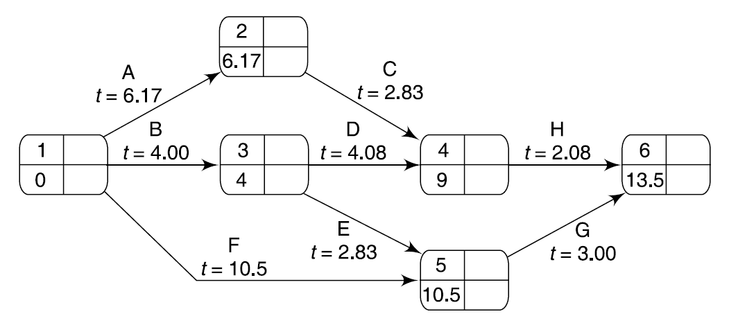

Slide 32
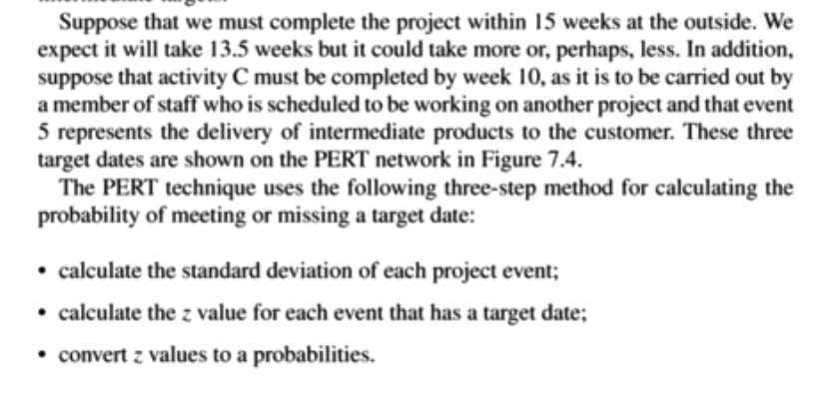
Given that:

Slide 33
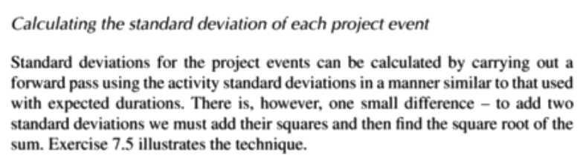
Calculating SD of each project event

Slide 34
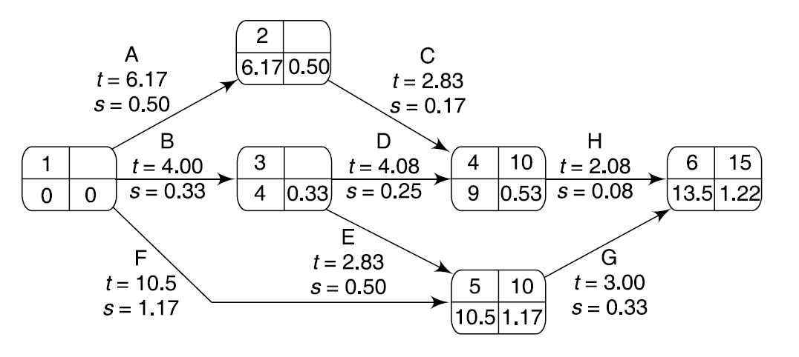
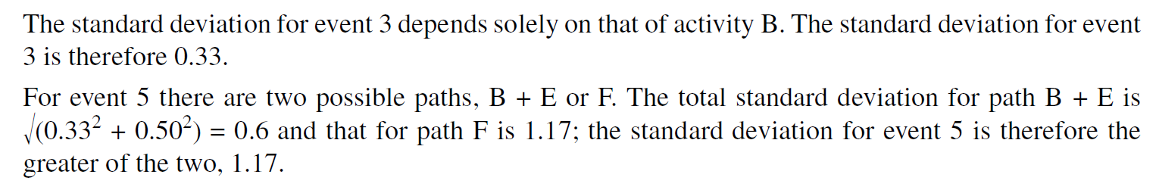

Slide 35
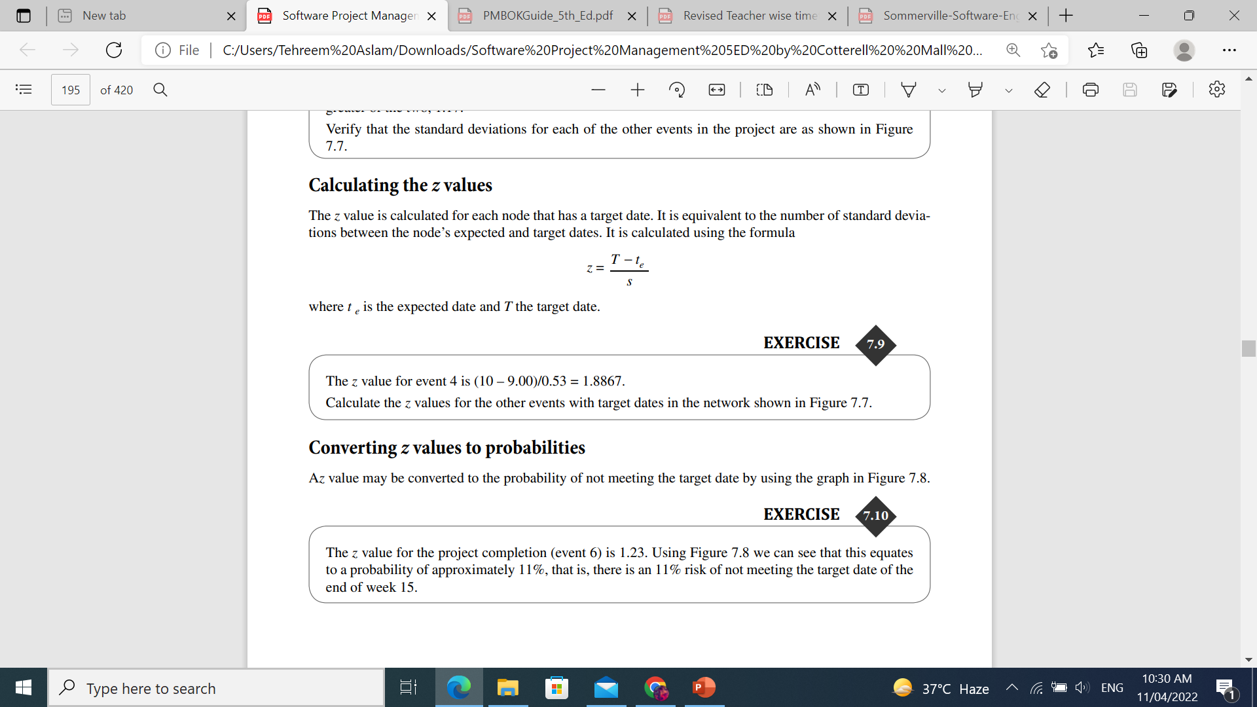
Calculate the Z values

Slide 36
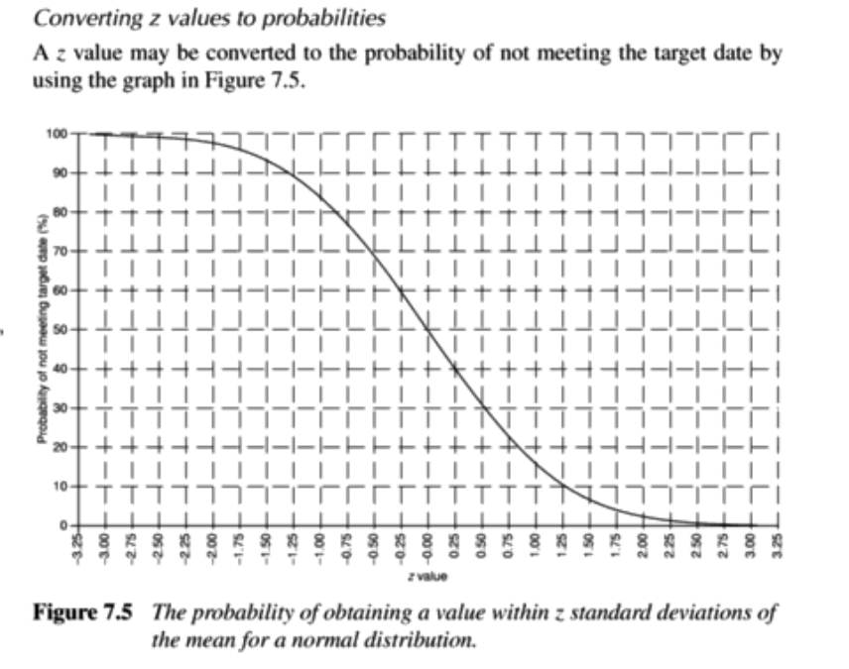


Slide 37
Activity
A project consists of the following activities, with their respective durations and dependencies:
Activity | Description | Predecessor(s) | Duration (days)
A | Site Preparation | None | 4
B | Foundation Work | A | 6
C | Frame Construction | A | 8
D | Electrical Wiring | B | 4
E | Plumbing | B | 5
F | Interior Finishing | C, D | 7
G | Roofing | C | 6
H | Landscaping | G | 5
I | Inspection | E, F, H | 3
J | Final Touches | I | 2

